Slide 1
Clackamas County Public Health
Accreditation Readiness
Community Health
Assessment & Improvement Planning

Slide 2
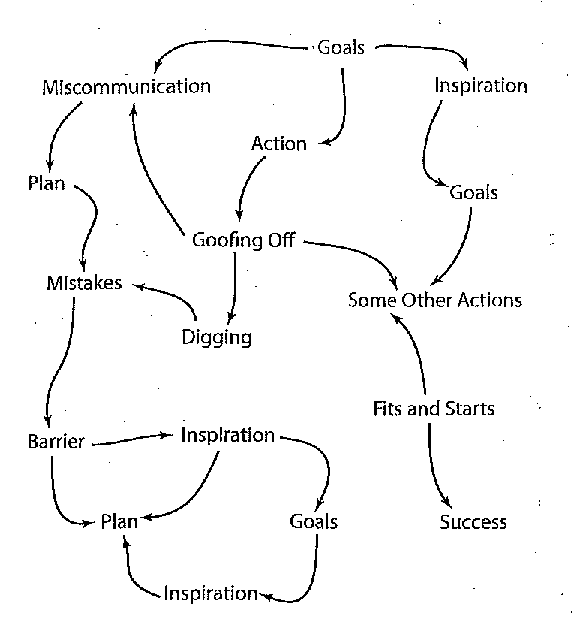
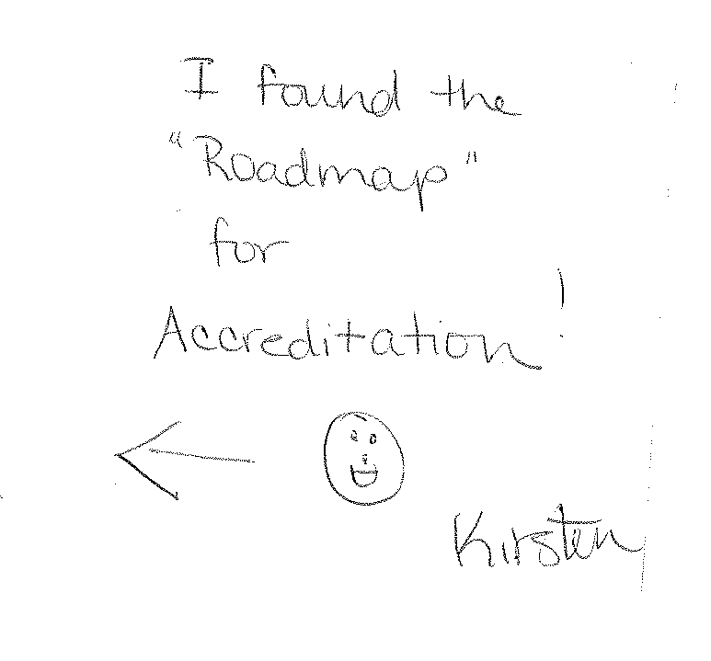

Slide 3
Overview
Accreditation Pre-Requisites
MAPP
Roadmap to Healthy Communities
Methodology
Bridge to CHIP
Recommendations for HIP

Slide 4
Pre-Requisites
Community Health Assessment
Community Health Improvement Plan
Public Health Dept Strategic Plan

Slide 5
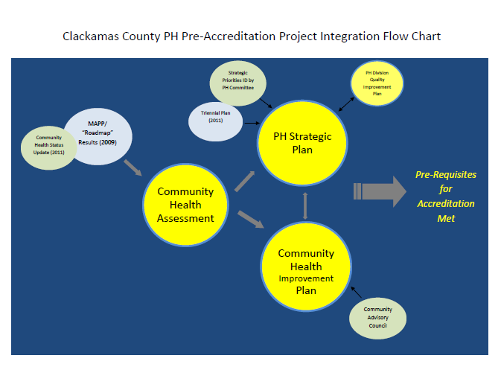

Slide 6
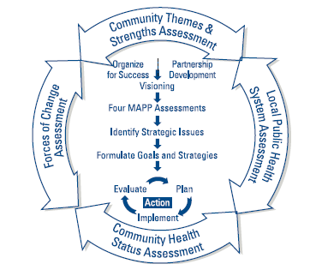
Mobilizing for Action through Planning & Partnerships:
A Community Approach to Health Improvement
Phase 1: Organize for Success/Partnership development
Phase 2: Visioning
Phase 3: Assessments (4)
Phase 4: Identify Strategic Issues
Phase 5: Formulate goals and strategies
Phase 6: Action Cycle
NACCHO Website – MAPP Resources www.naccho.org/topics/infrastructure/mapp/

Slide 7
Roadmap to Healthy Communities
Oregon City pilot
County-wide 2009
MAPP
Phase 1 Partnership Development
Phase 2 Visioning
Phase 3 Assessments
Phase 4 Identify Strategic Issues

Slide 8
Assessments
Community Themes and Strengths
Forces of Change Assessment
Local Public Health Assessment
Community Health Status Assessment

Slide 9
Methodology
Town Hall style Meetings
Online Survey
Paper (in-person) survey
Key informant interviews
Meeting in A Box

Slide 10
Community Priorities/Report
Individual Life Sustaining Essentials
Safe Neighborhoods
Clean air and water
Access to healthy food
Affordable healthcare
Quality Education
Housing
Jobs
Social, Physical, and emotional support
Green spaces and nature
Opportunities for Physical Activity
Support from family, friends, community
Elements that make a good community
Participation in decision making
Accessible transportation
Coordination of social services
Report: Executive Summary of Roadmap (MAPP) 2009:
www.clackamas.us/community_health/roadmap.jsp

Slide 11
Roadmap follow-up
Healthy Eating Active Living mini grants 2010-2011
  13 grantees received $2500 - $8000
  Recipients: schools, neighborhood associations, CBO’s, Farmer’s Market
  Projects: Community gardens/greenhouse, Built environment, Fitness classes, Nutrition classes
RFP for 2011-2012 mini grants
HEAL info on the web:
www.clackamas.us/community_health/roadmap.jsp

Slide 12
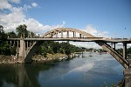
Bridge to CHIP
Continue Assessment
  Community Health Status Assessment – update
  Build capacity
Pick up with Phase (4) 5 and 6
Advisory Council for Health Improvement Plan

Slide 13
Recommendations
MAPP is adaptable
Assessment
  Know your population
  Don’t overlook traditional methods
  Representative sample
  multiple avenues
Strategize for your community
  Successful methods depend on many factors
Community Advisors – CHA vs CHIP
Utilize existing resources
Communications
Community engagement takes time
This is a learning process

Slide 14
Jennifer Eskridge, MPH, CHES
Policy Analyst/Accreditation Coordinator
Clackamas County Public Health
503-742-5956
JEskridge@co.clackamas.or.us

Slide 15
Performance Management
Program
Strengthening Public Health Infrastructure
for Improved Health Outcomes Grant
Notes:
Introduction
Outline of grant goals, strategies, status

Slide 16
Background
Funding from CDC to support infrastructure building within Oregon’s public health system.
Grant runs through September 2012. Future years TBD.

Slide 17
Grant Goal
Accelerate accreditation readiness for the public health system by
Providing tools and capacity building assistance for
local and state
accreditation, while
building a culture of continuous improvement
Notes:
Invest in local health accreditation preparation
Pursue State level accreditation
Continue to embed QI/CI in how we do our work

Slide 18

Grant Goal
Reshape the public health system through improved engagement with existing and emerging partners by
Providing tools and capacity
building assistance to
advocate for our role in
healthcare reform
Notes:
Enhance public health engagement in policy-making process that affect the health of Oregonians

Slide 19
How We Get There
Collaboration – Best Practices – Sustainability
Data Driven
Continuous
Improvement
Advocacy
Notes:
Data driven – Effectively utilizing data to inform decision making. Having access to tools to support analysis and data sharing.
Advocacy – Being able to effectively communicate what we have learned in our data collection and analysis. Getting the right message to the right people at the right time, in a way they want to hear.
Continuous Improvement– The foundation on which everything rests. How do we equip folks at all levels of the system to confidently participate in this new way of working?
Collaboration, Best Practices, Sustainability – Share the successes and lessons learned throughout the system so we can learn from one another.

Slide 20
What’s the Plan?
Data Driven
Health assessment tool(s) – crunch our data
Reporting system – share our data
Collaboration… Collaboration… Collaboration
Notes:
Goal: Enhance the public health system’s capacity to provide efficient and effective
services.
Develop and disseminate tool(s) to access, analyze and display data – CHAT and Performance Management System

Slide 21
Infrastructure and Workforce Development
Continuous Improvement
Develop and support training for the public health system
Provide technical assistance
Collaboration… Collaboration… Collaboration
Notes:
Standards around health assessments, QI, other accreditation needs TBD
How do we want to approach training? Online, webinar, in person, communities of practice, regional groups
Coaching

Slide 22
Sharing Our Good Work
Advocacy
Share our work the right way, at the right time, to the right people
Enhance existing partnerships and relationships
Build relationships with emerging partners
Collaboration… Collaboration… Collaboration
Notes:
Goal: Strengthen public health system partnerships and the public’s understanding of the importance of public health.
Activities:
· Assess public health system communication and share improvement results.
· Build cross-jurisdictional collaboration between public health and emerging partners

Slide 23
What’s Happening Now?
13 grants for LHD accreditation projects
Funding CLHO to hire a Local Accreditation Manager
Sharing existing QI training to build better system approach
Notes:
Benton, Clackamas, Columbia, Curry, Deschutes (for Central Oregon region), Lincoln, Linn, Marion, Multnomah, North Central Public Health District, Polk, Union and Yamhill.

Slide 24
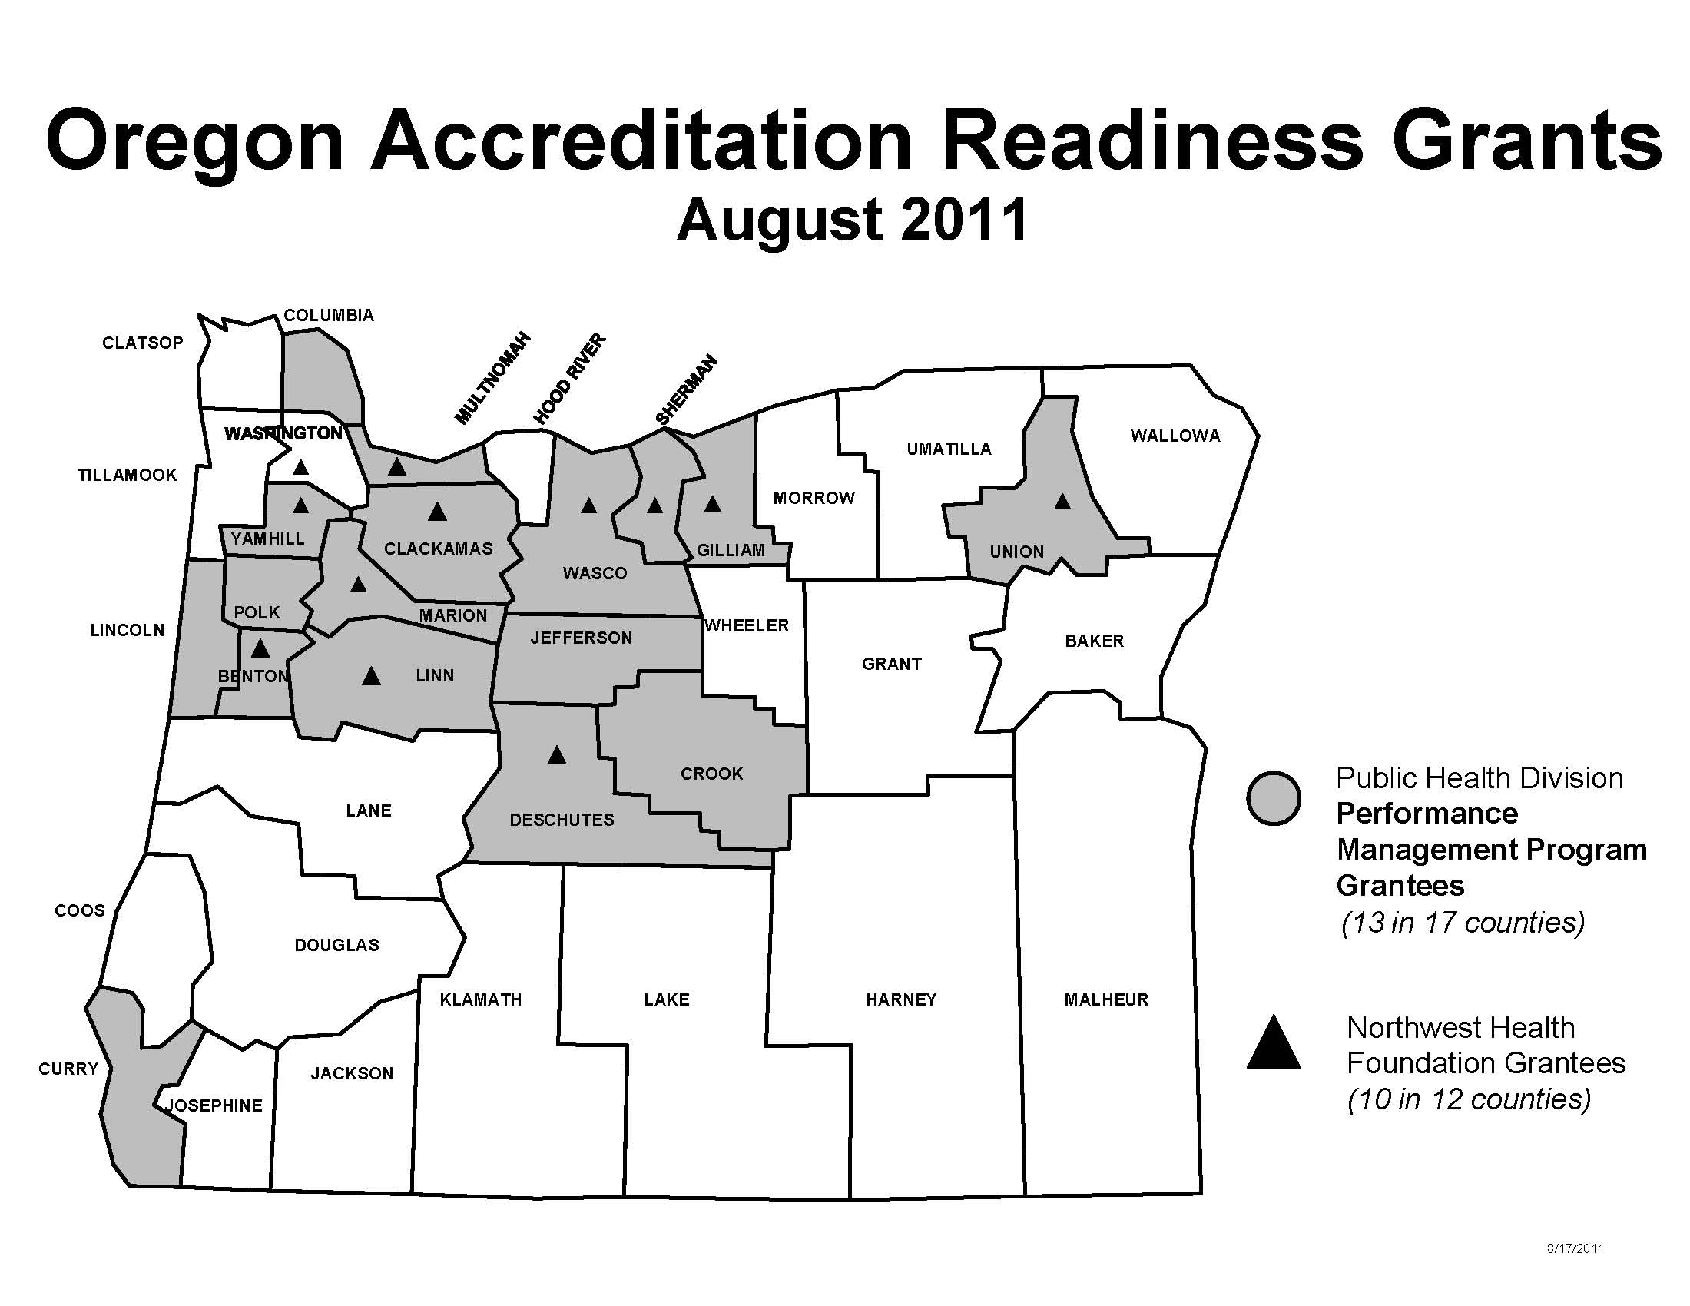
Local Grantees
Notes:
Benton County
Central Oregon Consortium
Clackamas County
Columbia County
Curry County
Lincoln County
Linn County
Marion County
Multnomah County
North Central Public Health District
Polk County
Union County
Yamhill County

Slide 25
What’s Happening Now?
Hiring State staff to coordinate the work
Developing connections to existing work groups, e.g., Accreditation Work Group, Community Health Assessment Partnership
Building requirements for OR-CHAT with a local/state/tribal work group

Slide 26
What’s Happening Next?
Plan for the Public Health Division’s accreditation work
  Strategic Plan
  Community Health Assessment
  Community Health Improvement Plan
  Complete our self
  assessment
Notes:
Know where we are…Where are going…How we are getting there
Excited to be on this journey to share what we do well and find ways to continually improve

Slide 27
Communicate
Performance Management Program
Quality
Promote a culture of continuous improvement in the PH system
Performance
Enhance the PH system’s capacity to provide efficient and effective services.
Partnerships
Strengthen PH system partnerships and the public’s understanding of the importance of PH.
Notes:
SHARE PMP Message Map

Slide 28
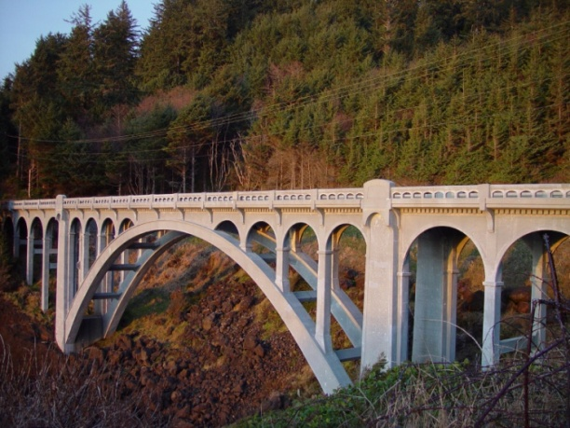

Find us online
Performance Management Program
http://1.usa.gov/PerformanceManagementProgram
PH Accreditation and Quality Improvement
http://1.usa.gov/AccreditationQI

Slide 29
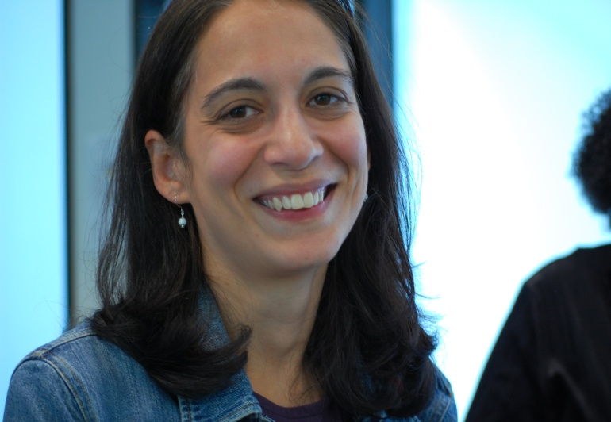
Contact Information
Lydia Emer
Performance Improvement Manager
Lydia.S.Emer@state.or.us
971-673-1223

